Slide 1
Understanding Requirements
Session 06
Course : Software Engineering
Effective Period : Desember 2017

Slide 2
These slides have been adapted from
Pressman, R.S. (2015). Software Engineering : A Practioner's Approach. 8th ed. McGraw-Hill Companies.Inc, Americas, New York. ISBN : 978 1 259 253157. Chapter 8
Acknowledgement

Slide 3
LO 2 : Explain the software engineering practices and business environment
Learning Objectives

Slide 4
Contents
Requirement Engineering
Building the Analysis Model
Analysis Patterns
Negotiating Requirements
Validating Requirements

Slide 5
Requirement Engineering
Inception—ask a set of questions that establish …
  basic understanding of the problem
  the people who want a solution
  the nature of the solution that is desired, and
  the effectiveness of preliminary communication and collaboration between the customer and the developer
Elicitation—elicit requirements from all stakeholders
Elaboration—create an analysis model that identifies data, function and behavioral requirements
Negotiation—agree on a deliverable system that is realistic for developers and customers

Slide 6
Requirement Engineering
Specification—can be any one (or more) of the following:
  A written document
  A set of models
  A formal mathematical
  A collection of user scenarios (use-cases)
  A prototype
Validation—a review mechanism that looks for
  errors in content or interpretation
  areas where clarification may be required
  missing information
  inconsistencies (a major problem when large products or systems are engineered)
  conflicting or unrealistic (unachievable) requirements.
Requirements management

Slide 7
Inception
Requirement Engineering
Identify stakeholders
  “who else do you think I should talk to?”
Recognize multiple points of view
Work toward collaboration
The first questions
  Who is behind the request for this work?
  Who will use the solution?
  What will be the economic benefit of a successful solution
  Is there another source for the solution that you need?

Slide 8
Eliciting Requirements
Requirement Engineering
meetings are conducted and attended by both software engineers and customers
rules for preparation and participation are established
an agenda is suggested
a "facilitator" (can be a customer, a developer, or an outsider) controls the meeting
a "definition mechanism" (can be work sheets, flip charts, or wall stickers or an electronic bulletin board, chat room or virtual forum) is used
the goal is
  to identify the problem
  propose elements of the solution
  negotiate different approaches, and
  specify a preliminary set of solution requirements

Slide 9
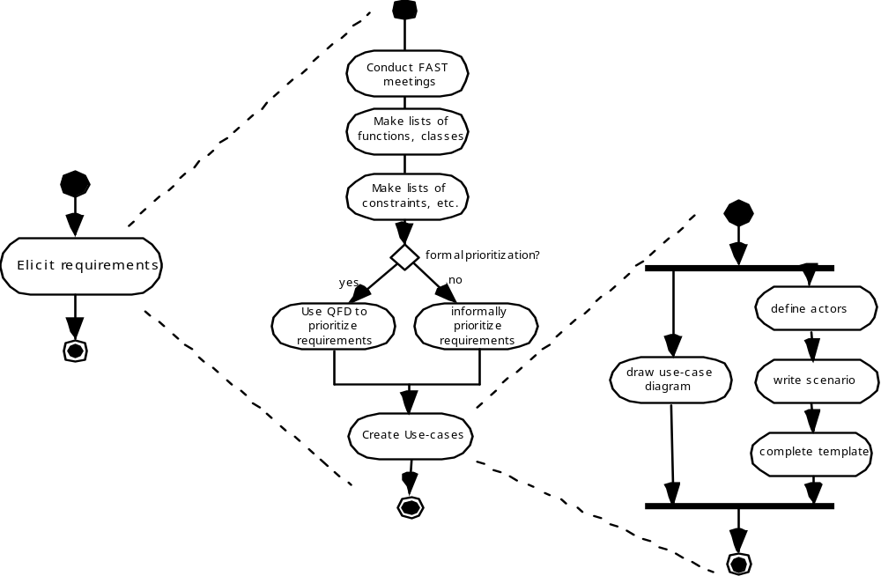
Eliciting Requirements
Requirement Engineering

Slide 10
Quality Function Deployment
Requirement Engineering
Function deployment determines the “value” (as perceived by the customer) of each function required of the system
Information deployment identifies data objects and events
Task deployment examines the behavior of the system
Value analysis determines the relative priority of requirements

Slide 11
Elicitation Work Products
Requirement Engineering
a statement of need and feasibility.
a bounded statement of scope for the system or product.
a list of customers, users, and other stakeholders who participated in requirements elicitation
a description of the system’s technical environment.
a list of requirements (preferably organized by function) and the domain constraints that apply to each.
a set of usage scenarios that provide insight into the use of the system or product under different operating conditions.
any prototypes developed to better define requirements.

Slide 12
Building the Analysis Model
Elements of the analysis model :
Scenario-based elements
  Functional—processing narratives for software functions
  Use-case—descriptions of the interaction between an “actor” and the system
Class-based elements
  Implied by scenarios
Behavioral elements
  State diagram
Flow-oriented elements
  Data flow diagram

Slide 13
Use-Cases
Building the Analysis Model
A collection of user scenarios that describe the thread of usage of a system
Each scenario is described from the point-of-view of an “actor”—a person or device that interacts with the software in some way
Each scenario answers the following questions:
  Who is the primary actor, the secondary actor (s)?
  What are the actor’s goals?
  What preconditions should exist before the story begins?
  What main tasks or functions are performed by the actor?
  What extensions might be considered as the story is described?
  What variations in the actor’s interaction are possible?
  What system information will the actor acquire, produce, or change?
  Will the actor have to inform the system about changes in the external environment?
  What information does the actor desire from the system?
  Does the actor wish to be informed about unexpected changes?

Slide 14
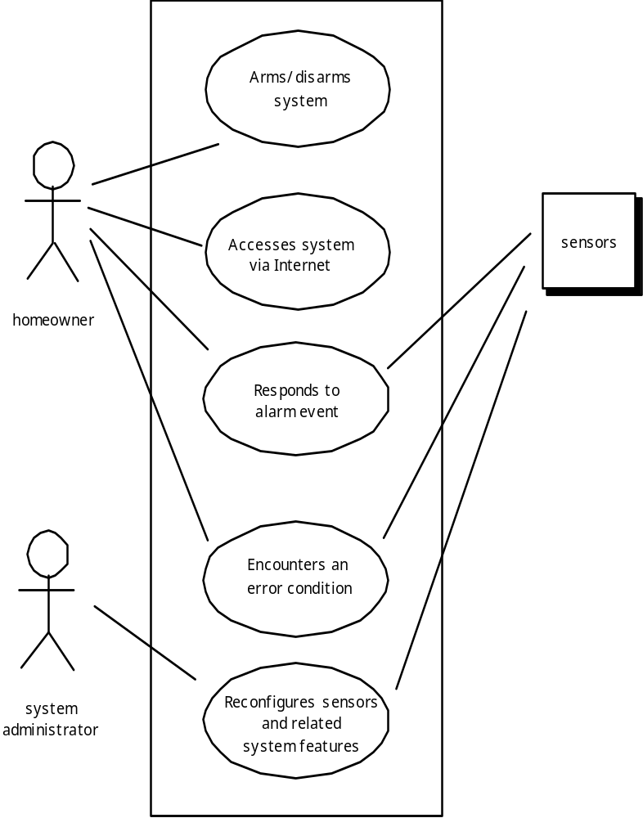
Use-Case Diagram
Building the Analysis Model

Slide 15
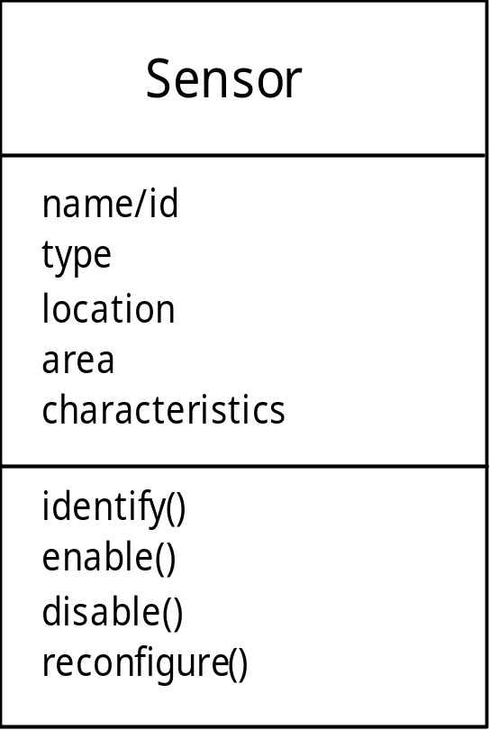
Class Diagram
Building the Analysis Model
From the SafeHome system …

Slide 16
State Diagram
Building the Analysis Model
Reading
Commands
State name
System status = “ready”
Display msg = “enter cmd”
Display status = steady
State variables
Entry/subsystems ready
Do: poll user input panel
Do: read user input
Do: interpret user input
State activities

Slide 17
Analysis Patterns
  Pattern name: A descriptor that captures the essence of the pattern.
  Intent: Describes what the pattern accomplishes or represents
  Motivation: A scenario that illustrates how the pattern can be used to address the problem.
  Forces and context: A description of external issues (forces) that can affect how the pattern is used and also the external issues that will be resolved when the pattern is applied.
  Solution: A description of how the pattern is applied to solve the problem with an emphasis on structural and behavioral issues.
  Consequences: Addresses what happens when the pattern is applied and what trade-offs exist during its application.
  Design: Discusses how the analysis pattern can be achieved through the use of known design patterns.
  Known uses: Examples of uses within actual systems.
  Related patterns: On e or more analysis patterns that are related to the named pattern because (1) it is commonly used with the named pattern; (2) it is structurally similar to the named pattern; (3) it is a variation of the named pattern.

Slide 18
Negotiating Requirements
Identify the key stakeholders
  These are the people who will be involved in the negotiation
Determine each of the stakeholders “win conditions”
  Win conditions are not always obvious
Negotiate
  Work toward a set of requirements that lead to “win-win”

Slide 19
Validating Requirements
Is each requirement achievable in the technical environment that will house the system or product?
Is each requirement testable, once implemented?
Does the requirements model properly reflect the information, function and behavior of the system to be built.
Has the requirements model been “partitioned” in a way that exposes progressively more detailed information about the system.
Have requirements patterns been used to simplify the requirements model. Have all patterns been properly validated? Are all patterns consistent with customer requirements?

Slide 20
Exercises
Discuss some of the problems that occur when requirements must be elicited from three or four different customers
Develop a complete use case for one of the following
a. Making a withdrawal at an ATM
b. Using your charge card for a meal at a restaurant
c. Buying a stock using an online brokerage account
d. Searching for books (on a specific topic) using an on-line bookstore
Describe what an analysis pattern is in your own words

Slide 21
References
Pressman, R.S. (2015). Software Engineering : A Practioner's Approach. 8th ed. McGraw-Hill Companies.Inc, Americas, New York. ISBN : 978 1 259 253157
Requirements Engineering / Specification, http://www.youtube.com/watch?v=wEr6mwquPLY
Collaborative Requirements Management, http://www.youtube.com/watch?v=tEXizjE05LA

Slide 22
Q & A

